Slide 1
Introduction to Information Systems and Programming
Java Introduction

Slide 2
Java syntax is relatively simple, and Java is very portable
Simple syntax
Java BNF (Syntax): 50 rules
C++ BNF: 140 rules
BNF: Backus Normal Form: A technique to describe the syntax of programming languages
Portable
can run on any computer / device with Java virtual machine (JVM)
E.g. Python is great, but don’t work on all platform

Slide 3
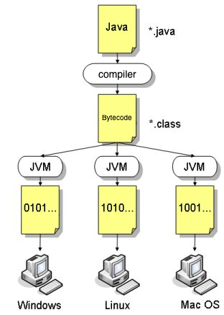
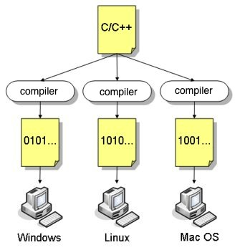
About JAVA’s portability
-High-level programming languages have to be translated into machine-language before the program can be executed
-By compiler
Machine codes are platform-specific, not portable, not suitable for connected computers

Slide 4
About JAVA’s portability
-Java programs are compiled into a specific type of machine language called bytecode
-Bytecode can be run on any computer with a JVM
-JVM: a software that interprets Java bytecode

Slide 5
Android Studio
We use Android Studio to program JAVA
IDE = Integrated development Environment: edit, compile, build, debug, etc
Other IDE: Eclipse

Slide 6
Android Studio: Create Project
Quick Start -> Start a new Android Studio project
Select the form factors: Phone and Tablet
Select ‘Add No Activity’
Application name: MyApp01
Minimum SDK: API 14
View -> Tool Windows -> Project

Slide 7
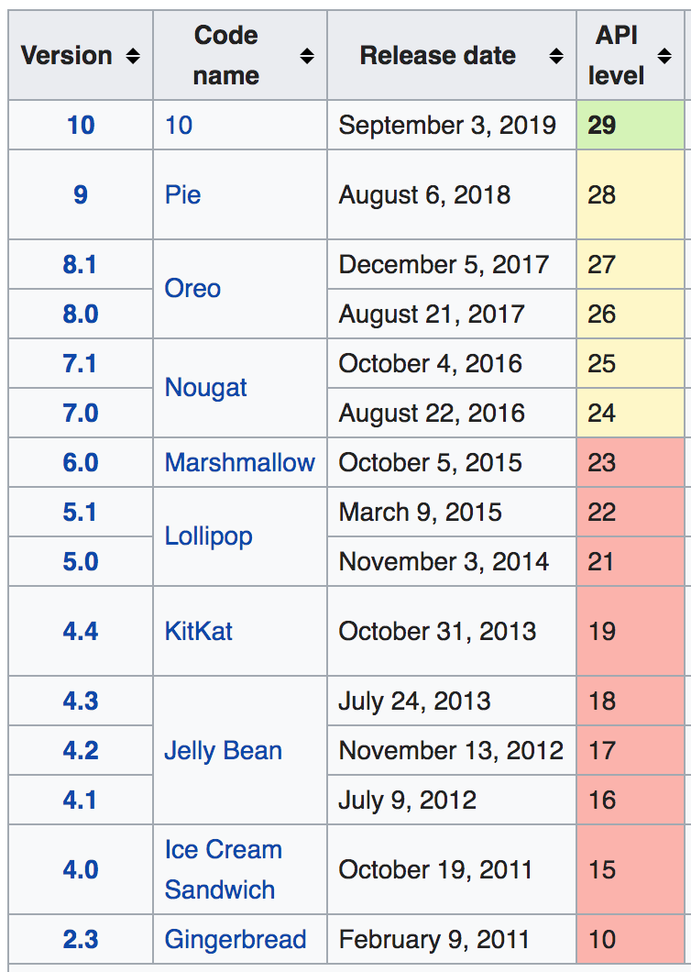
Android Studio: Create Project

Slide 8
Android Studio: Create Module
File -> New -> New Module
Choose ‘Java Library’, press <Enter>
Library name: lib01, press <Enter>
Add code to MyClass
To remove a module: File->Project structure, choose module, select ‘-’

Slide 9
public class MyClass {
public static void main(String[] args) {
System.out.println("Hello World”);
}
}
Every Java program must contain at least one class that defines the data and methods (functions)
JVM executes the program from the main method
void: does not have any return value
public: accessibility modifier; MyClass can be used anyway in the program

Slide 10
Android Studio: Run the program
Run -> Edit configurations
Select ‘+’ (Add new configuration) -> Application
Name: Java Application
Main class: <package>.<module>.MyClass
Use classpath of module: lib01
Run -> Run ‘Java Application’

Slide 11
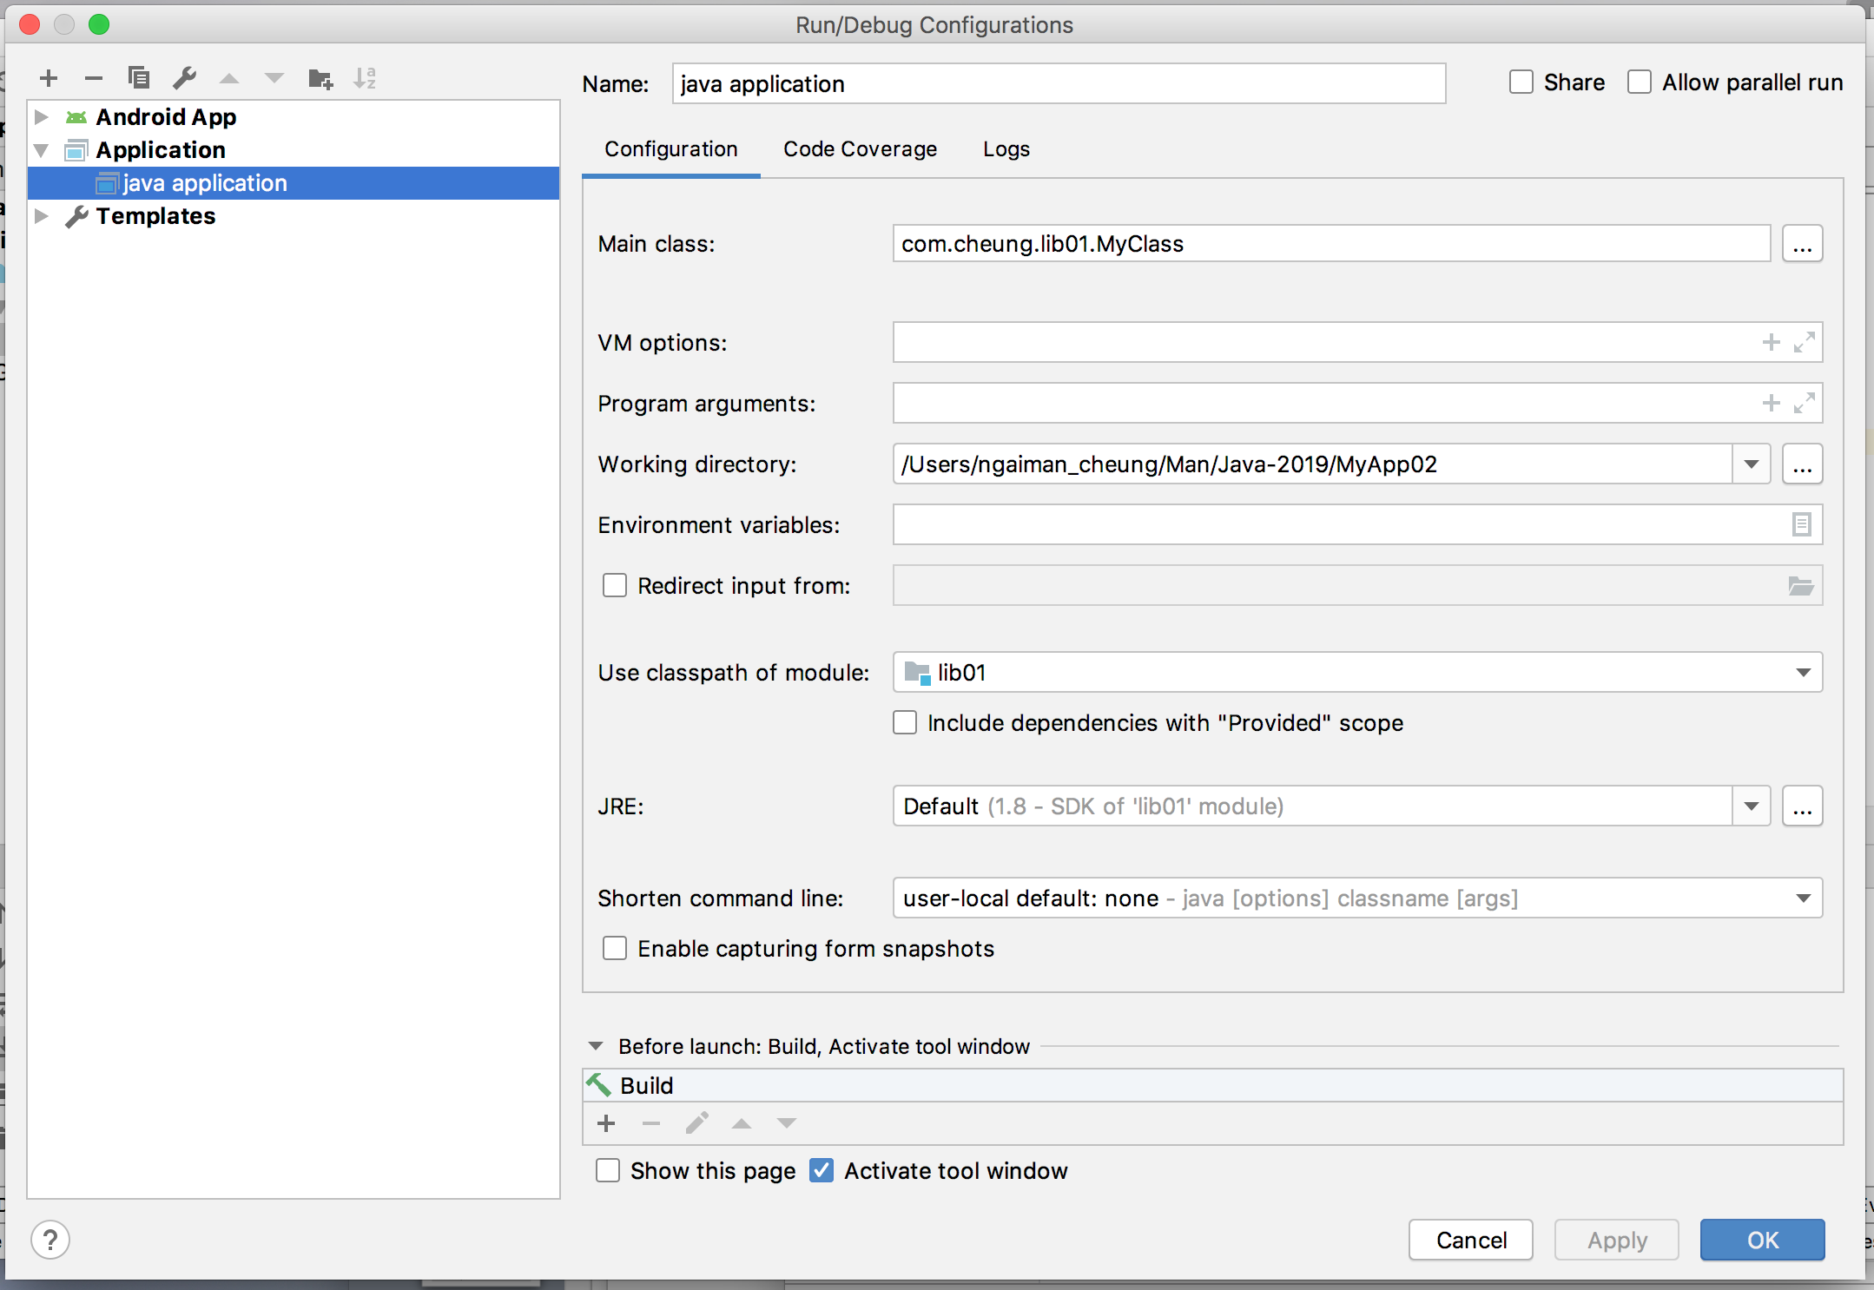
Android Studio: Run the program

Slide 12
Your first Helloworld JAVA program
Activity: create a new module “lib02”, create a new class “HelloWorld” that produces the follow printout:
Hello World!!!
Hello from SUTD!!!
Note that you need to change the Java class name when creating the module, and update the ‘Java Application’ run configuration for the Main class and classpath

Slide 13
Your first Helloworld JAVA program
public class HelloWorld {
public static void main (String[] args){
System.out.println("Hello World!!!");
System.out.println("Hello from SUTD!!!");
}
}

Slide 14
1. Variables
Variables are used to store data in a program
In Java, you have to specify what type of data a variable represents: variable declaration
int a = 0;
int b = 1;
P.S. There are 4 types of variables:
- Non static
- Static
- Local
- Parameters
http://docs.oracle.com/javase/tutorial/java/nutsandbolts/variables.html

Slide 15
1. Variables
Class name usually start with Capital letter
class Demo {
public static void main(String[] args) {
int a = 0;
}
variable name usually start with small letter

Slide 16
2. array
-Array is used to store a collection of data
int[] c; // declare a variable to reference the array
c = new int[3]; // allocate memory for 3 int
c[0]=17; // assign value
c[1]=23;
c[2]=38;
System.out.println(“0th value:“+ c[0]);
System.out.println(“1st value:“+ c[1]);
System.out.println(“2nd value:“+ c[2]);
Concatenate string

Slide 17
Array – what’s happening behind
int[] c;
c = new int[3];
c[0]=17;
c[1]=23;
c
Type: int[]
c is declared as a variable of reference to an array (of integer)

Slide 18
Array – what’s happening behind
int[] c;
c = new int[3];
c[0]=17;
c[1]=23;
0th
1st
2nd
c
Type: int
Type: int
Type: int
Type: int[]
Three int memory are allocated. The array reference is assigned to c

Slide 19
Array – what’s happening behind
int[] c;
c = new int[3];
c[0]=17;
c[1]=23;
0th
1st
2nd
c
17
Type: int
Type: int
Type: int
Type: int[]
We assign value 17 to the c[0] memory cell
(not assign 17 to c. c is just a reference)

Slide 20
Array – what’s happening behind
int[] c;
c = new int[3];
c[0]=17;
c[1]=23;
0th
1st
2nd
c
17
23
Type: int
Type: int
Type: int
Type: int[]

Slide 21
3. String
-String is a sequence of characters
String d = “HelloXDD”;
int len = d.length();
System.out.println(d);
System.out.println(len);

Slide 22
3. String
class Demo {
public static void main(String[] args) {
String d = “HelloXDD”;
int len = d.length();
System.out.println(d);
System.out.println(len);
}
}
What is len?

Slide 23
3. String
class Demo {
public static void main(String[] args) {
String d = “HelloXDD”;
int len = d.length();
System.out.println(d);
System.out.println(len);
}
}
len is 8

Slide 24
3. String
Alternative way to create a String object
char[] dArray = { 'h', 'e', 'l', 'l', 'o', ’X’, ‘D’, ‘D’ };
String dString = new String(dArray);
System.out.println(dString);

Slide 25
4. If then
If-then-else: selective statements and conditional execution
int simonWeight = 99999; // in kg. OH NO….
String advice = “”; // this is an empty string
if (simonWeight <= 75) {
advice = “fit”;
} else if (simonWeight <= 100) {
advice = “eat less”;
} else if (simonWeight <= 150) {
advice = “no dinner”;
} else {
advice = “no dinner no breakfast no tea no lunch”;
}
What is the advice?

Slide 26
5. for-loop
Loop: program construct to control repeated execution of a block of statements
for(int i=1; i<=4; i++){
System.out.println("Count is: " + i);
}
Initial action
Loop continuation condition
Action after each iteration

Slide 27
5. for-loop
Loop: program construct to control repeated execution of a block of statements
for(int i=1; i<=4; i++){
System.out.println("Count is: " + i);
}
Initial action
Loop continuation condition
Action after each iteration
The output will be:
Count is: 1
Count is: 2
Count is: 3
Count is: 4

Slide 28
6. Method (function, operation)
Declare a method
class Demo {
public static void printHAHA() {
System.out.println(”HAHA”);
}
public static void main(String[] args) {
printHAHA();
}
}
Use a method

Slide 29
6. Method – with argument
name of method
class Demo {
public static void printa(int a) {
System.out.println(a);
}
public static void main(String[] args) {
printa(3);
}
}
argument
It will print out the number 3

Slide 30
6. Method – return a value
This method will return an int
class Demo {
public static int four() {
return 4;
}
public static void main(String[] args) {
int answer = four();
}
}
answer will be equal to 4

Slide 31
Activity
Write a JAVA program that print out the first n numbers in the Fibonacci sequence
http://en.wikipedia.org/wiki/Fibonacci_number
try different solution (e.g. using/not using array, for loop, method…)

Slide 32
Reference of JAVA syntax
All can be found here:
http://docs.oracle.com/javase/tutorial/java/nutsandbolts/index.html

